Slide 1
FILTERS AND DENOISING
ADITYA SINGH 2K19/EP/005

Slide 2
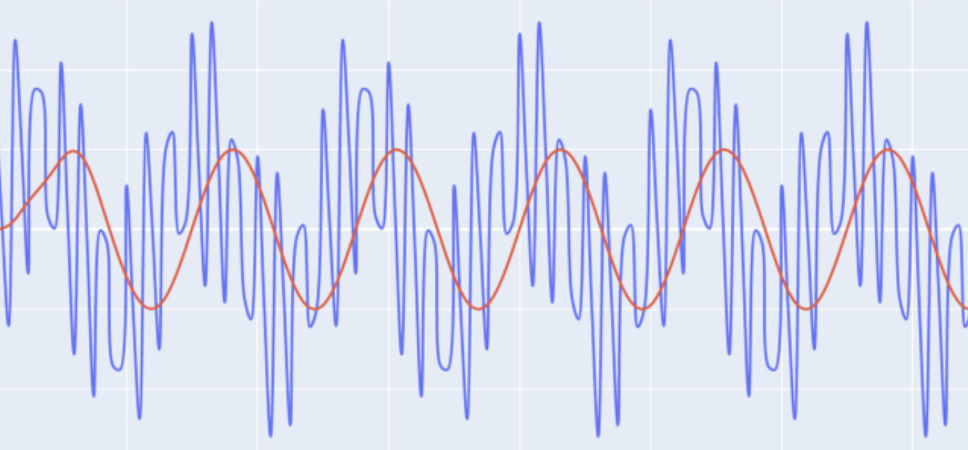
FILTERS !
A filter is a circuit that removes, or “filters out,” a specified range of frequency components. In other words, it separates the signal’s spectrum into frequency components that will be passed and frequency components that will be blocked.
These filters are made up of passive components such as resistors, capacitors and inductors and have no amplifying elements (transistors, op-amps, etc) so have no signal gain, therefore their output level is always less than the input.

Slide 3
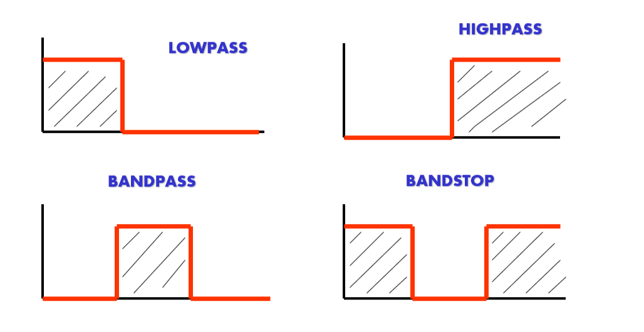
TYPES OF FILTERS

Slide 4
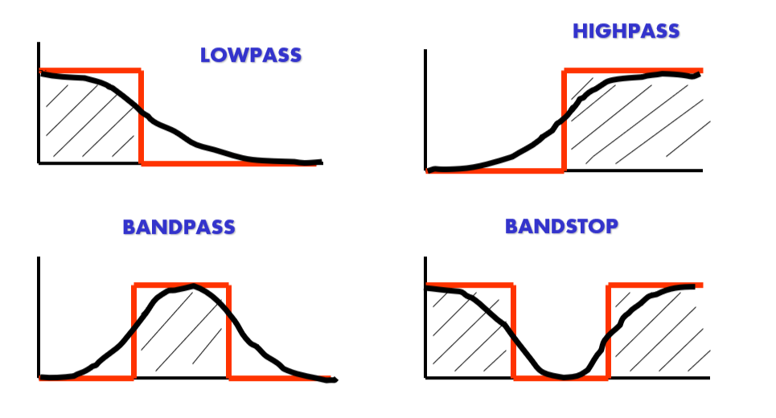
TYPES OF FILTERS

Slide 5
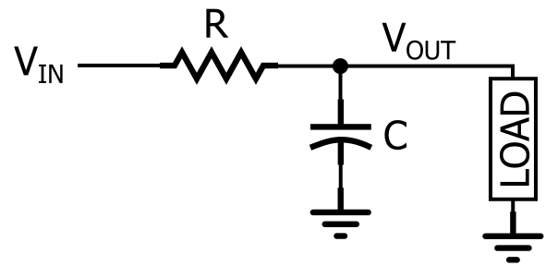
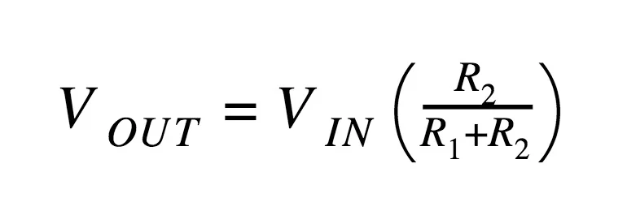
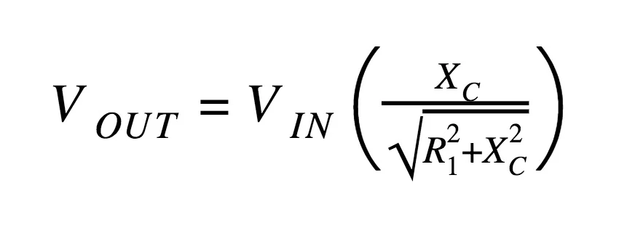
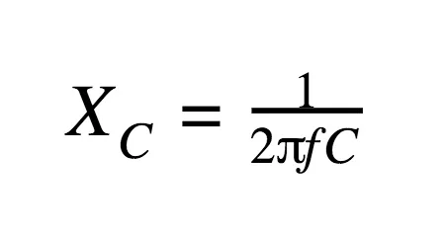
RC LOW PASS CIRCUIT

Slide 6
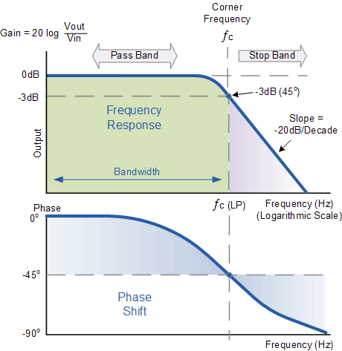
BANDWIDTH DIAGRAM

Slide 7
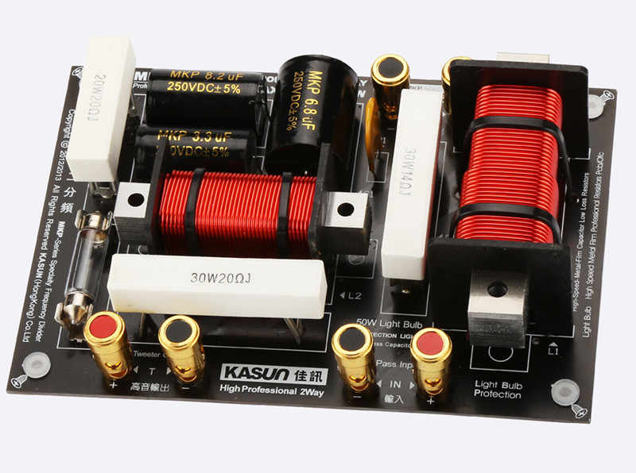
APPLICATIONS
The tuner in radio: The bandpass filter in the tuner of the radio allows a fixed frequency to the output speaker.
Treble & bass of the speaker: The bass has lower frequencies & treble has higher frequencies. They are separated using high pass & low pass filter and are separately routed to corresponding bass speaker & treble speaker for clear music.
Anti-Aliasing: it is a low pass filter that filters out the high-frequency components from a signal before sampling. It prevents the aliasing component form being sampled.
Power Supply Smoothing: The output of the power supply which is a rectifier has an AC ripple in it. These frequencies are filtered out using a low pass filter which results in smoothing the output signal.
Noise suppression: They are used in communication systems for noise removal from the received signals.

Slide 8
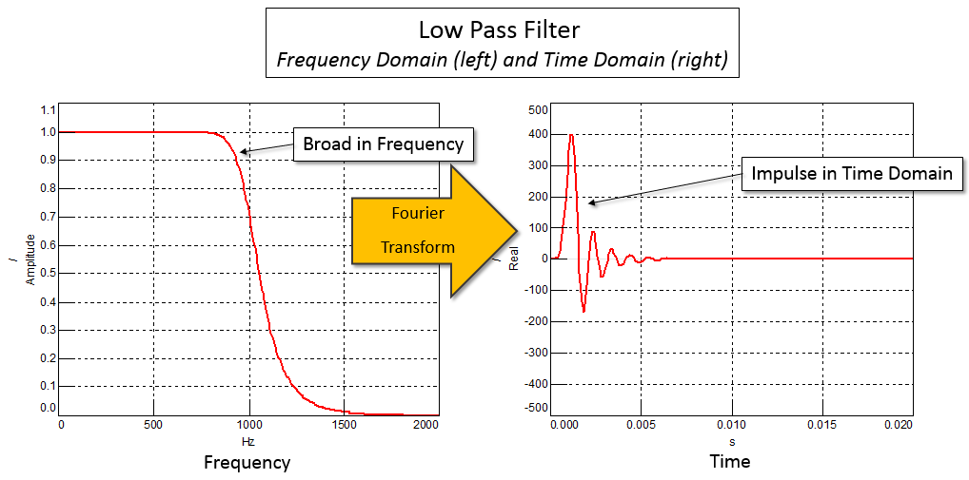
FIR versus IIR
Two classes of digital filters are Finite Impulse Response (FIR) and Infinite Impulse Response (IIR).
The term ‘Impulse Response’ refers to the appearance of the filter in the time domain. Filters typically have broad frequency responses, which correspond to short duration pulses in the time domain

Slide 9
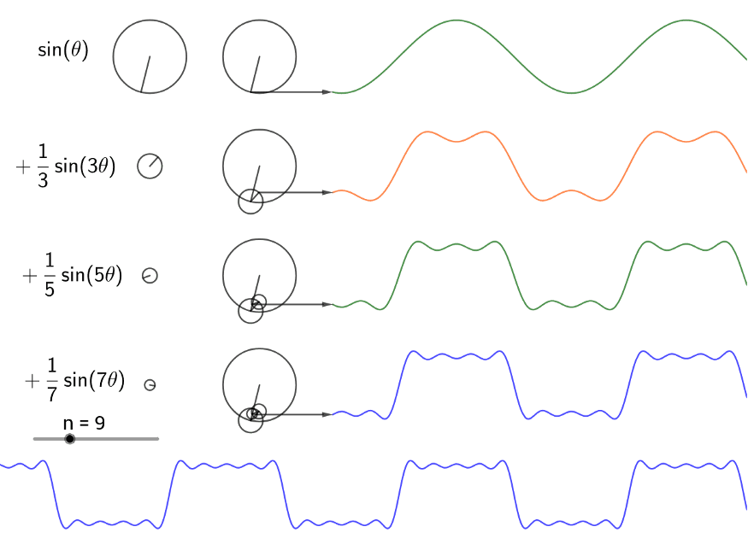
NOISE REDUCTION
All signal processing devices, both analog and digital, have traits that make them susceptible to noise. Noise can be random or white noise with an even frequency distribution, or frequency-dependent noise introduced by a device's mechanism or signal processing algorithms.

Slide 10
PYTHON SIMULATION
Import required python packages - matplotlib, numpy and scipy for computations.
Generate a signal and add noise to it.
Take spectral analysis - compute fast fourier transform.
Apply a filter to remove noise.
Plot the filtered signal.

Slide 11
FAST FOURIER TRANSFORM
The FFT is a fast, O[NlogN] algorithm to compute the Discrete Fourier Transform (DFT), which naively is an O[N²] computation.
Fourier Transform is used to convert signal from time domain into the frequency domain.
It allows us to:
Check the signal’s behaviour in the frequency domain.
Perform some functions in frequency domain.

Slide 12
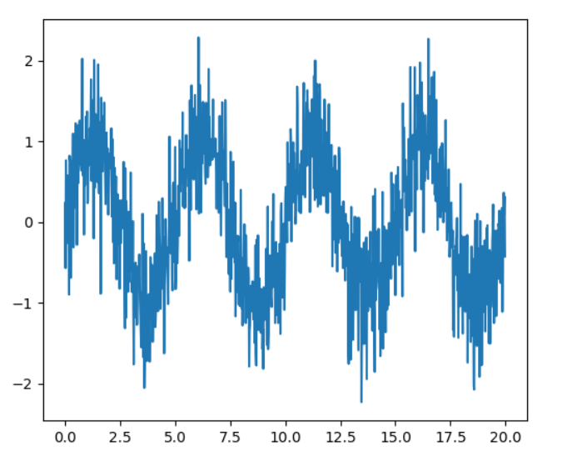
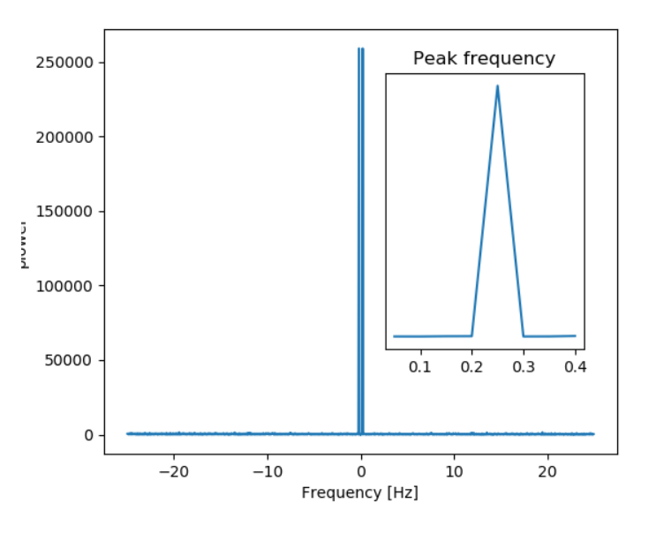

Slide 13
THANK YOU

